Slide 1



Let’s Play
QUIZ GAME
BY
VISHAL
MUHAMMED RAZI
Aman JAzIM
FIZA NOOR
yokeshwari

Slide 2



INTRODUCTION
MCQ QUIZ GAME USING PYTHON
In the ever-evolving world of programming, interactive applications play a pivotal role in learning and engagement. This project, titled "MCQ Quiz Game using Python", is a simple yet effective command-line-based multiple-choice quiz system built entirely in Python.
The primary goal of this game is to test users’ knowledge across various subjects by presenting them with a series of multiple-choice questions (MCQs). Players must choose the correct answer from four options. At the end of the game, the program evaluates the responses, displays the score, and may even showcase a leaderboard highlighting top performers.

Slide 3

STEPS FOLLOWED TO DEVELOP THE MCQ QUIZ GAME IN PYTHON
Part 1
1. Planning the Game Structure
2. Preparing the Questions
3. Building the Game Logic
4. Scoring System
5. Final Score Display
6. Leaderboard
7. Testing and Debugging

Slide 4

WHY WE CHOSE TO BUILD AN MCQ QUIZ GAME USING PYTHON
Part 2
1. To Apply Core Python Concepts Practically
2. To Learn File Handling
3. To Understand Conditional Logic
4. To Practice Clean Code and Modularity
5. To Add Fun Elements and Motivation
6. To Prepare for Real-World Projects

Slide 5
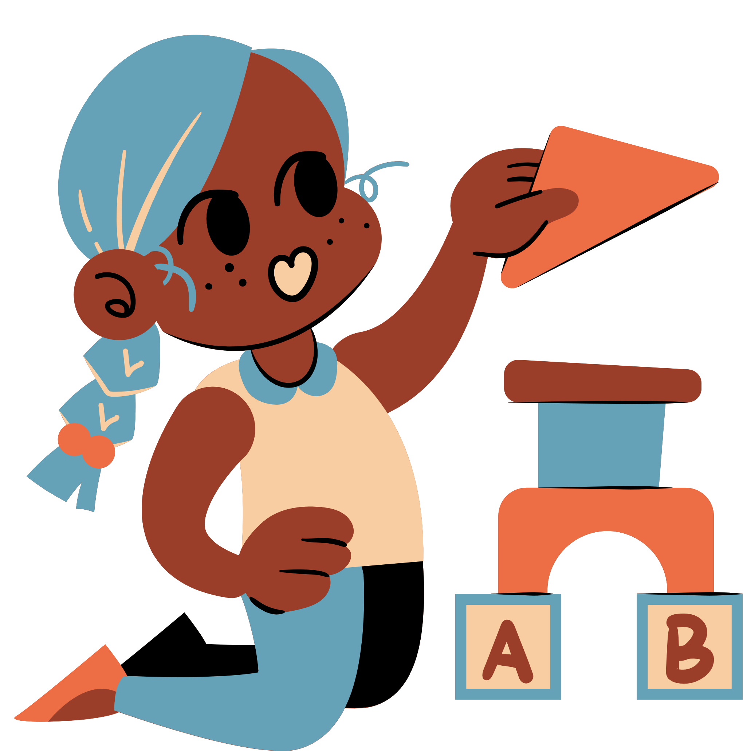

Part 3
FUTURE SCOPE OF THE MCQ QUIZ GAME USING PYTHON
As simple as it may seem now, this MCQ Quiz Game has massive potential for expansion and real-world application. With just a few upgrades, this humble command-line game can evolve into a full-fledged educational platform.
Online Multiplayer Mode
Admin Panel for Question Management
Question Bank from Database
User Login & Profiles
Analytics & Performance Feedback
Voice-Based Quiz (AI Integration)

Slide 6

CONCLUSION
Part 4
The MCQ Quiz Game using Python is a simple yet powerful application that demonstrates how programming can be used to create interactive and educational tools. Through this project, we explored fundamental Python concepts such as loops, conditionals, functions, data structures, and optional file handling — all woven together into a real-world use case.
By simulating a real-time quiz environment, the project encourages critical thinking and attention to detail, both for the developer and the player.
Moreover, it serves as a strong foundation for future enhancements like graphical interfaces, multiplayer modes, user accounts, and performance analytics.
In conclusion, this project highlights how even beginner-level programming skills can be channeled to build meaningful, functional applications that are both fun and educational — paving the way for more advanced and impactful software solutions in the future.

Slide 7
THANK YOU

